Slide 1

GRIDLOCK AI: Zero-Tolerance Grid Security
Project Title
GRIDLOCK AI: Zero-Tolerance Grid Security
Team: The Aegis
Diya Dibyanshi, Rinuvarshini K R, Arunya V, Nithila Sabapathy
Hackathon
HackaThrone 2025
College
VIT Chennai

Slide 2
The $80 Billion Grid Bleed: Problem Statement
The world's energy infrastructure faces critical vulnerabilities leading to monumental financial losses and grid instability. This requires a paradigm shift from reactive monitoring to proactive, zero-tolerance security.
Annual Financial Loss
Reactive Systems
Lack of Forensic Proof
Global electricity theft and grid faults result in an estimated $80 billion in losses annually, directly impacting utility revenues and consumer costs.
Current monitoring systems are inherently slow and reactive, failing to detect tampering or incipient faults until significant damage has occurred.
Existing logs are often centralised and editable, lacking the tamper-proof evidence required for legal compliance and revenue recovery efforts.
Our objective is to create a Zero-Tolerance Predictive Security Layer that detects theft or faults the instant they start, ensuring immediate mitigation.

Slide 3




Motivation: Securing the Grid, Unlocking Value
Beyond preventing loss, GRIDLOCK AI introduces transformative opportunities for efficiency, compliance, and sustainability in energy management.
Financial Accuracy
Operational Efficiency
Stopping theft and reducing unbilled energy immediately ensures accurate revenue recovery and improved utility balance sheets.
Predictive anomaly detection enables timely maintenance, reducing costly outages and extending asset lifespan.
Legal Compliance
Sustainability Impact
Decentralised Web3 logs provide immutable, forensically sound proof of incidents, supporting legal actions.
Preventing energy wastage and optimising grid health directly contributes to corporate ESG (Environmental, Social, and Governance) goals.

Slide 4





System Architecture: The Predictive Security Loop
GRIDLOCK AI leverages a modern, distributed architecture to ensure real-time data ingestion, intelligent analysis, and tamper-proof logging.
IoT Edge
ESP32 (Simulated/Real) device reading V–I–P data.
API Gateway
FastAPI endpoint for high-throughput data ingestion.
AI Core
Predictive AI Model calculates anomaly score.
Human Interface
Streamlit Dashboard for real-time visualisation and alerts.
Integrity Layer
Web3 Ledger for immutable logging of anomalies.

Slide 5




Methodology: A Four-Pillar Approach
Our solution is built on sequential steps, combining edge computing with advanced AI and decentralised ledger technology for maximum security.
The Edge Feed
The Predictive Brain
ESP32 continuously streams high-frequency Voltage (V), Current (I), and Power (P) data via a robust FastAPI microservice.
A Random Forest or LSTM model analyses incoming data streams to calculate a real-time anomaly score, predicting faults or theft patterns.
The Control Centre
The Decentralised Log
The Streamlit dashboard provides operational oversight, visualising data trends and flashing critical alerts in real time for human intervention.
All anomaly alerts are cryptographically committed to a blockchain-based ledger, ensuring data integrity and preventing retrospective tampering.

Slide 6
Technology Stack: Built for Scale and Security
We selected cutting-edge, open-source technologies to deliver a cost-effective, scalable, and highly performant solution.
AI/ML Core
Backend API
Python, Scikit-learn / LSTM
User Interface
For pattern recognition and predictive anomaly scoring.
Data Integrity
Edge Computing
FastAPI
Communication
High-performance, modern REST API for real-time data handling.
Streamlit
Simple, effective live dashboard for anomaly visualisation.
Web3 Ledger (Blockchain)
Ensuring immutable and verifiable proof-of-incident logging.
ESP32 Microcontroller
Simulating smart meter data acquisition at the grid edge.

Slide 7
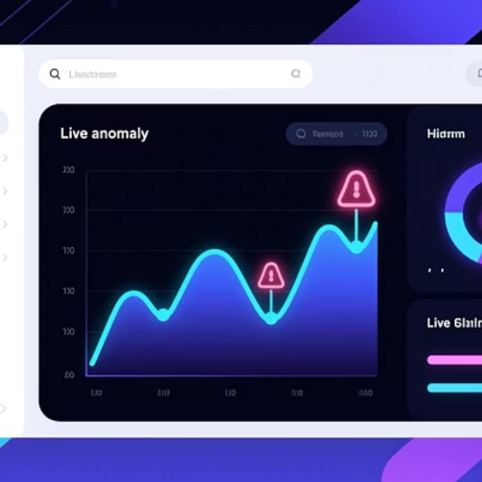
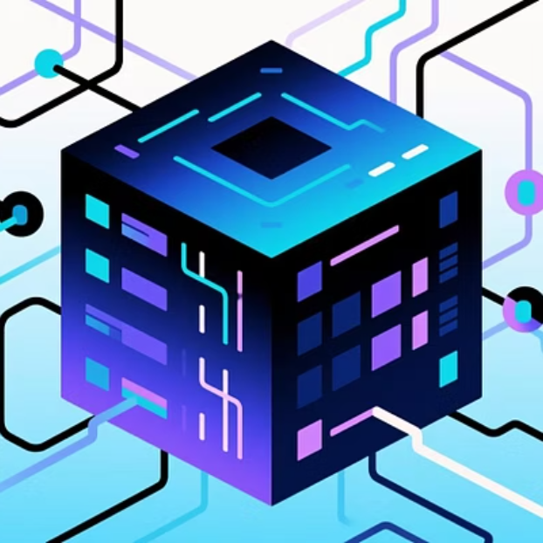
Key Results and Outputs
Our prototype demonstrates superior performance metrics in detection speed, accuracy, and data security—the three pillars of grid resilience.
95%
<2s
100%
Detection Accuracy
Alert Latency
Data Integrity
AI model success rate in identifying grid faults and theft signatures during testing phase.
Time taken from data stream ingestion to dashboard alert notification.
All incidents are logged as verified, immutable entries on the decentralised ledger.

Slide 8
Advantages Over Traditional Systems
GRIDLOCK AI fundamentally redefines grid security by prioritising prediction, immutability, and open-source affordability.
Detection Method
Manual, delayed inspection, and simple thresholding.
Predictive, AI-driven, real-time anomaly scoring.
Evidence Logging
Centralised database logs; prone to editing and disputes.
Decentralised, tamper-proof ledger via Web3 technology.
Cost Model
High initial investment, proprietary software licensing.
Low-cost, modular, and leverages open-source tools.
Response Type
Reactive analysis after an event has occurred.
Proactive mitigation, anticipating failures or theft.
Scalability
Limited by expensive hardware and centralised infrastructure.
Modular and global, deploying easily on millions of smart meters.

Slide 9

Future Scope: From Prototype to Production
The next phase of development focuses on deploying the system in a real-world environment and enhancing its capabilities for continuous learning and resilience.
Hardware Integration: Deploy model directly onto real ESP32 nodes for true edge computing performance.
Full Blockchain Layer: Integrate with a live Web3 ecosystem using IPFS for data storage and an Ethereum test net for contract execution.
Automated Alerts: Implement an SMS/email auto-alert system for immediate stakeholder notification of critical incidents.
Cloud Deployment: Containerise the backend using Docker and deploy on enterprise cloud platforms (Render/AWS) for global availability.
Adaptive Retraining: Enable continuous, adaptive retraining of the AI model to maintain high accuracy against evolving theft techniques.

Slide 10






GRIDLOCK AI: Powering a Secure Grid Future
GRIDLOCK AI transforms grid security from a liability into a highly predictive, digital asset. Our innovation lies in the secure fusion of three powerful technological forces.
IoT Edge
Scalable, low-cost sensor network providing high-fidelity, real-time grid data.
AI Prediction
A self-learning sentinel detecting anomalies before financial or operational loss occurs.
Web3 Integrity
Tamper-proof evidence logging for irrefutable compliance and forensic utility.
“We built an AI that predicts the attack, stops the loss, and secures the proof on-chain.”
Thank you.

